Slide 1
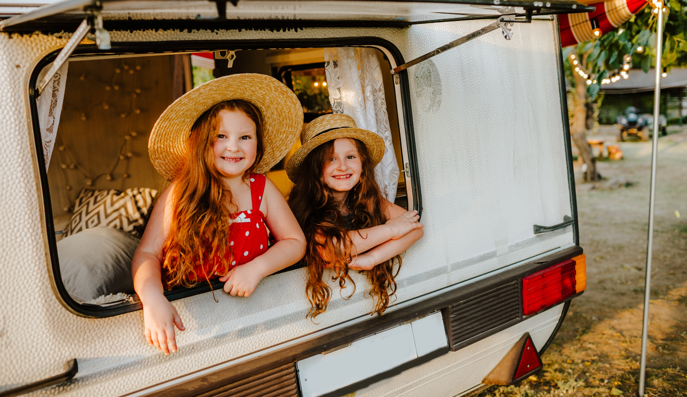
Gypsy, Roma, Traveller History Month
Copyright Devon County Council 2023
Notes:
Welcome to this presentation about Gypsy, Roma, Traveller History Month. We hope that by the end of this presentation you will have a better understanding of the history and culture of these communities.

Slide 2
What is Gypsy, Roma, Traveller History Month? - GRTHM
Notes:
So, what exactly is Gypsy, Roma, Traveller History Month? Or GRTHM for short?

Slide 3
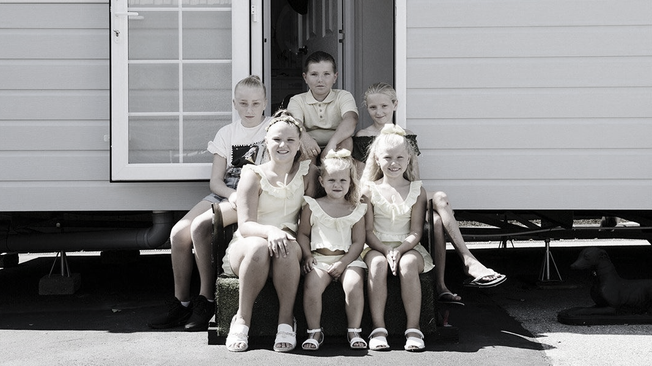
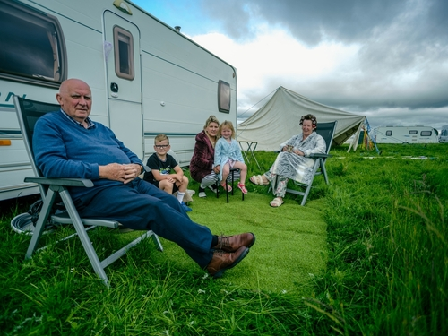
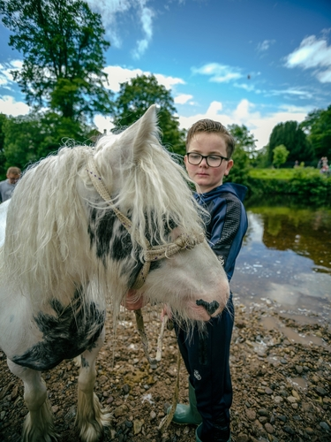
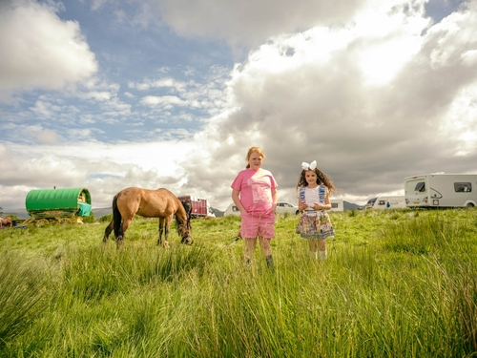
Gypsy, Roma Traveller History Month is celebrated every year throughout June.
Notes:
Gypsies, Roma and Travellers are the largest ethnic minority community in the European Union with over 12 million people across the EU and some 300,000 in the UK. In many countries, they are marginalised and sometimes suffer extreme levels of prejudice and discrimination.
GRTHM is recognised by the Department for Education.

Slide 4
History of Gypsy, Roma, Travellers
Notes:
The history of Gypsy, Roma and Travellers is long, rich and varied.
Did you know that being settled and living in one place is actually a recent development? For 99% of our history, humans were nomadic. Up until around 10,000 years ago, our ancestors moved around in large family groups, moving with their food supplies and available resources. This was a survival strategy and people only owned what they could easily transport.

Slide 5
An animated history…
Notes:
When farming became commonplace, most people started to establish permanent settlements. However, not everyone settled down. We are going to watch a short film that explains the history of Travellers and their culture.

Slide 6
Problems faced by Gypsies and Travellers
Notes:
As the narrator said in the film, however they live, Travellers take their language, culture and memories with them. Traveller culture is an important part of our country’s culture and we need to protect it and celebrate it. Travellers should be able to be proud of their roots and their heritage. In the UK, we live in a diverse, multicultural society and that society includes Travellers. The law states that Travellers must be treated equally but this does not always happen. Travellers sometimes suffer discrimination, both at school and in the wider community.

Slide 7
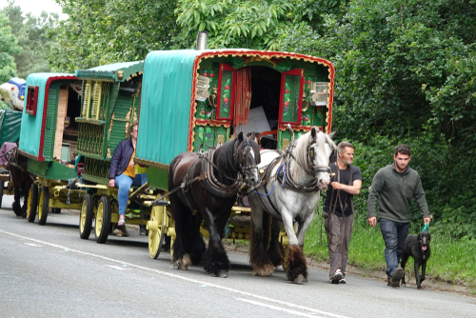
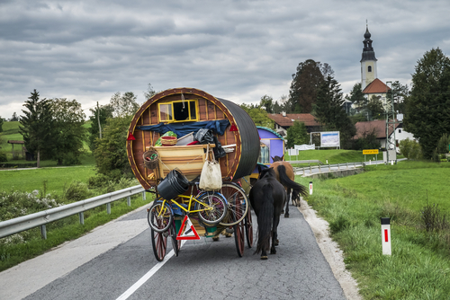
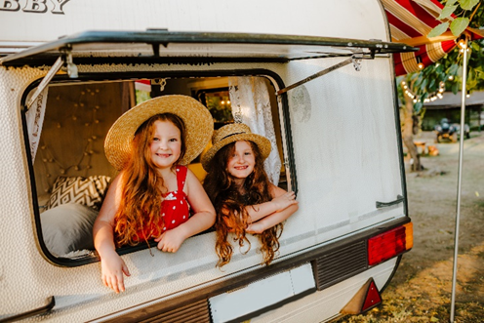
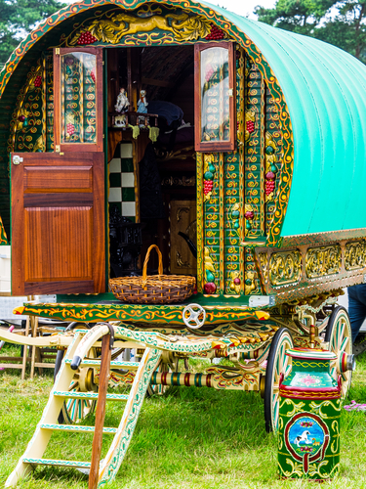
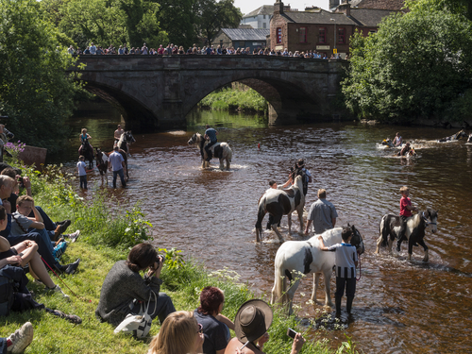
Notes:
Gypsies and Travellers have been subjected to hundreds of years of prejudice and persecution. This is largely due to a lack of understanding about the traditional ways of life.
For example, during the Holocaust in the second world war, Gypsies and Travellers were killed in mass genocide carried out by the Nazis. However even today, there remains many misconceptions about Gypsies, Roma and Travellers, such as they don’t pay taxes, they live illegally, they are dirty but there is a lot we can learn from Traveller communities. Their lifestyle includes strong family values, they look after their elderly relatives in their homes as well as rearing children with good morals of respect and hard work. Their custom is also to ensure that children learn crucial life skills such as running a business, cooking, cleaning and hands-on skills.
GRTHM aims to change these misconceptions and educate people about the traditions and histories of Gypsy and Traveller cultures.

Slide 8
Equality is about treating everyone fairly, and
with respect and consideration. Many Traveller
children are reluctant to say that they are
Travellers because they are scared of
discrimination.
Notes:
“We are far more united and have far more in common with each other than that which divides us.”
Travellers need to feel that they are just as welcome in our society as anyone else. It’s within your power to help make this happen.

Slide 9
For further information or support please contact:
Ellen Tout – Gypsy, Roma, Traveller, Showman Advisory Teacher
ellen.tout@devon.gov.uk

